Slide 1
Introduction to Causal Machine Learning
Amit Sharma
Principal Researcher
Microsoft Research
www.amitsharma.in Twitter: @amt_shrma
Notes:
Machine learning→
Decision-making
RL

Slide 2
Two session series on Causal ML
Session 1: Intro to causal machine learning
Estimating causal effect, explaining outcomes, and out-of-distribution generalization
Session 2: Causal machine learning in practice
PyWhy/DoWhy and the promise of large language models

Slide 3
Session goals: Intro to causal machine learning
What is the difference between causal and predictive machine learning (ML)?
Side-goal: Learn about causality fundamentals
When is causal ML useful?
What can you achieve with causality + ML?
Looking forward: Take better decisions
Looking backward: Explain the reasons for observed outcomes
Improving ML models: Better generalization of ML models

Slide 4
Outline
What is causal ML and why do we need it?
What can you achieve using causal ML?
When is it practically useful compared to predictive ML?
Fundamental concepts in causality
Interventions and counterfactuals
Causal graph
Three main applications
Choosing the “best” decision for a target outcome
Attributing causes for a target outcome
Building predictive models that generalize out-of-distribution

Slide 5
Section 1: What is causal ML and why do we need it?

Slide 6
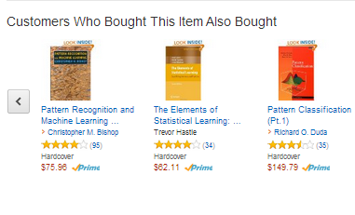
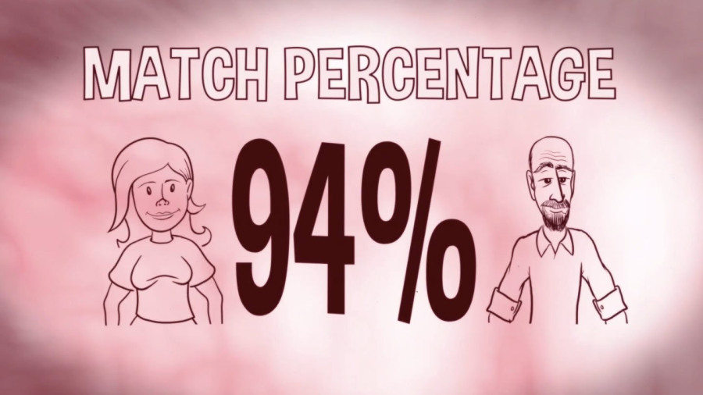
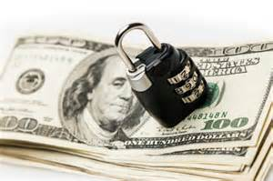
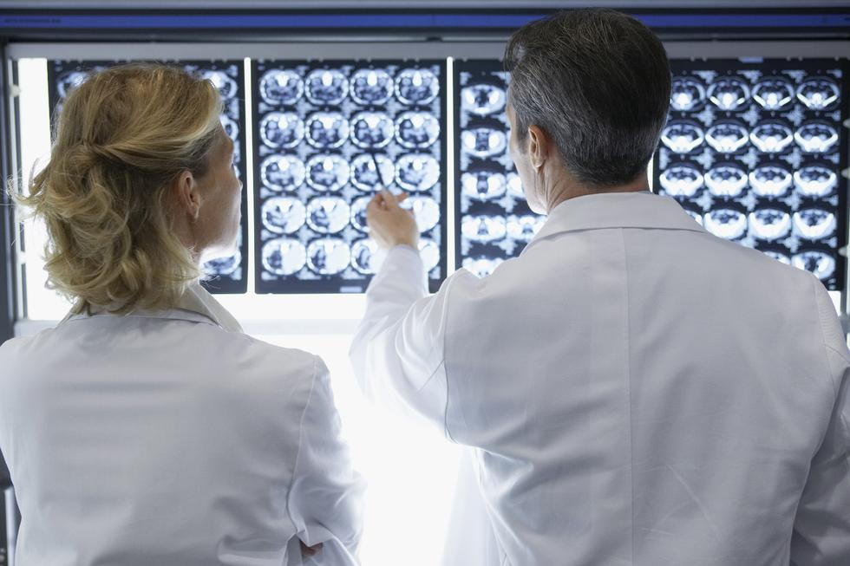
When we think of machine learning, we often think of predictions: What does the data say?

Slide 7

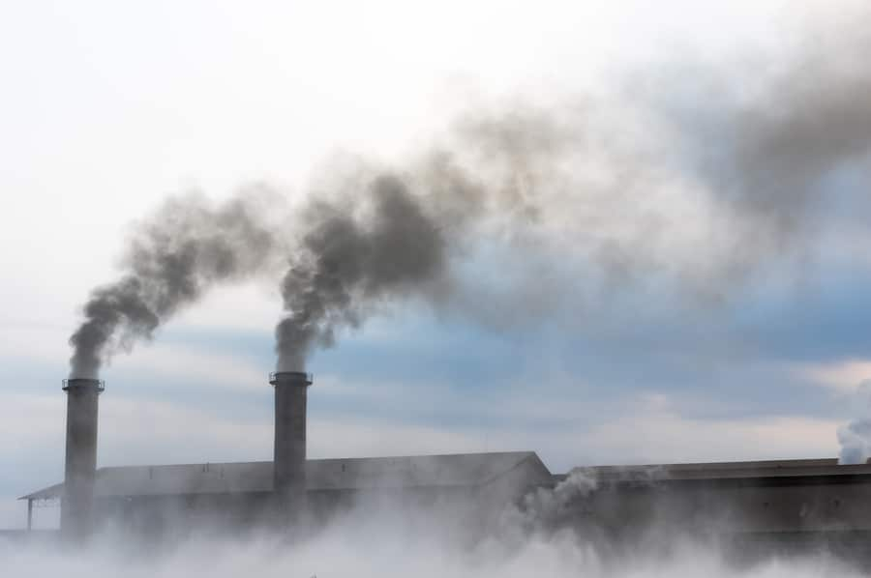

But there’s an important class of problems about decisions: what action should I take?
Which customers should we provide discounts to improve sales?
Which treatment will have the best improvement for a patient?
What is the best way to share an important public safety message?
Would this government regulation lead to a decrease in air pollution?

Slide 8
Sometimes, these problems overlap…
Accurate prediction also means accurate decision-making.
Prediction task: Does the X-ray image indicate a tumor?
Decision task: Should we give tumor treatment or not?

Slide 9
But sometimes, they do not
Prediction task: Predict the customers most likely to churn out.
Decision task: Who to provide discounts to?
Discounts may not work on people likely to churn out (low activity)
May be unnecessary for people with high activity.
Only need to find the people in the middle, who are undecided.

Slide 10
Reason: Correlation versus causation
Product usage
Today’s product usage can predict tomorrow’s probability of churn (not renewing contract).
But does not tell us anything about effect of discount.
Effect could even be zero!
Discount
Renew contract

Slide 11
And often, decision-making requires solving a new kind of problem: effect estimation
Effect estimation: What is the effect of an action on the outcome?
What is the best way to share an important public safety message?
Q: What is the effect of sharing medium on response rate for the safety message?
Would this government regulation lead to a decrease in air pollution?
Q: What is the effect of the regulation on air pollution?

Slide 12
In effect estimation, the most important task is how to avoid being fooled by correlations
What is the best way to share an important public safety message?
Would this government regulation lead to a decrease in air pollution?
Observed data: The response rate of text messages is the highest.
Selection bias: Dataset contains mostly young people.
Observed data: In other states, pollution decreased after the regulation. Confounding bias: Other states differ on the kind of industries they have.

Slide 13
So, how to solve these problems in a systematic way? Incorporate techniques for learning causality in ML models.

Slide 14

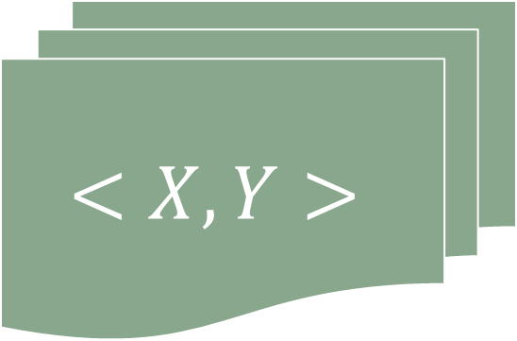



Causal ML is about inferring the best actions (and the effects of actions in general)
Prediction ML: 𝑦=h(𝑥)+𝜖
Causal ML: $${∂f(x,u)}/{∂x}$$
$$<X,Y>$$
$$<X,Y>$$
True: 𝑦=f(𝑥,u)+𝜖
$$\hat{y}$$
$$β$$
Hofman, Sharma, and Watts (2017). Prediction and Explanation in Social Systems. Science, 355.6324

Slide 15




Three key applications of causal ML: Better decision-making (what to do next?)
People who do not cycle have high cholesterol
People who cycle regularly have low cholesterol
Decision: To improve cholesterol levels of the population, should the city government invest in programs for encouraging cycling (e.g., giving free bikes)?

Slide 16
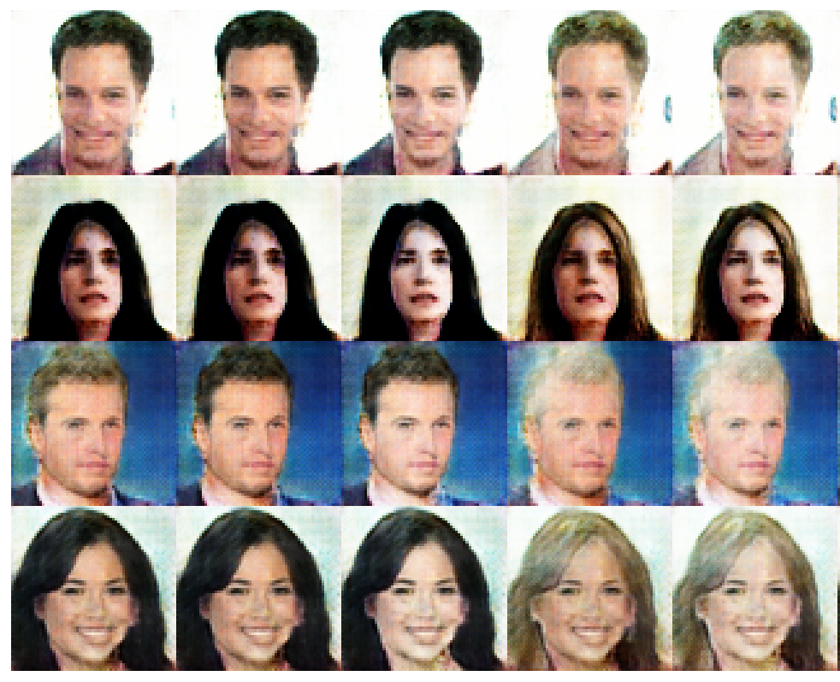
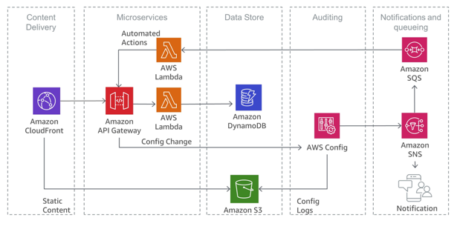
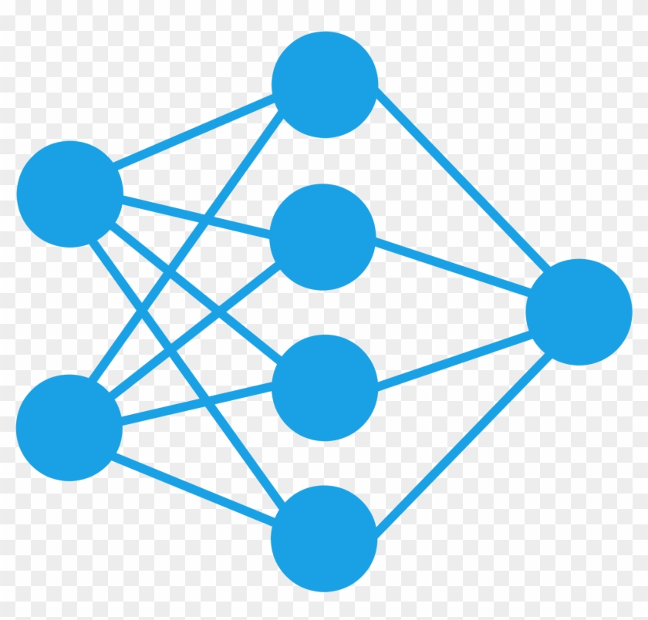
Three key applications of causal ML: Root cause attribution (why did this happen?)
Predicted Class
Class: 1
Class: 0
Class: 0
Class: 1
Attribution: Why did the classifier predict Class:1 for the first image?
Attribution: For a given the microservice system, why did the latency increase?

Slide 17
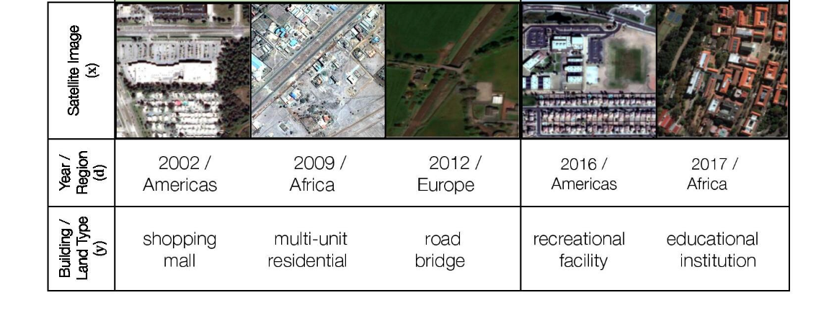
Three key applications of causal ML: Out-of-distribution generalization
Koh et al., WILDS, ICML 2021

Slide 18
Causal ML: Machine learning + causality A necessary ingredient for general-purpose AI
To summarize,

Slide 19
Section 2: Fundamental concepts in causality (intervention, counterfactual, & causal graph)

Slide 20
Intervention: A formal definition for taking an action
Intervention: An active action taken that changes the distribution of a variable T.
Different from observing two different values of T.
Intervention
Observed data
Cycling (T)={0,0,1}
Interventional data
Cycling (T)={1,0,1}

Slide 21
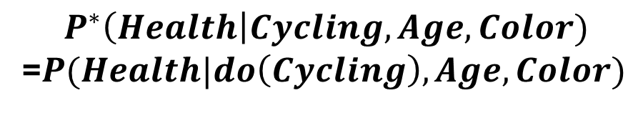
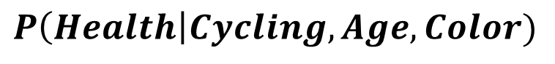
Mathematically represented using the do-operator
Intervention
Observed data
Cycling (T)={0,0,1}
Interventional data
Cycling (T)={1,0,1}
$$P^{∗}\left(Health\right|Cycling, Age, Color)$$
=$P(Health|do\left(Cycling\right), Age, Color)$
$$P\left(Health\right|Cycling, Age, Color)$$

Slide 22
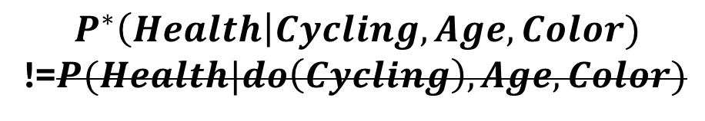
Important: A do-intervention affects only the desired variable, keeping everything else fixed
Not an Intervention
Observed data 1
Cycling (T)={0,0,1}
Observed data 2
Cycling (T)={1,0,1}
$$P^{∗}\left(Health\right|Cycling, Age, Color)$$
!=$P(Health|do\left(Cycling\right), Age, Color)$
$$P\left(Health\right|Cycling, Age, Color)$$

Slide 23





Second important concept: counterfactual (What would have happened if)
Real World
Counterfactual World
Intervention
Intervention
$$Health_{t}$$
$$Health_{t+1}$$
$$Health_{t}$$
$$?$$

Slide 24
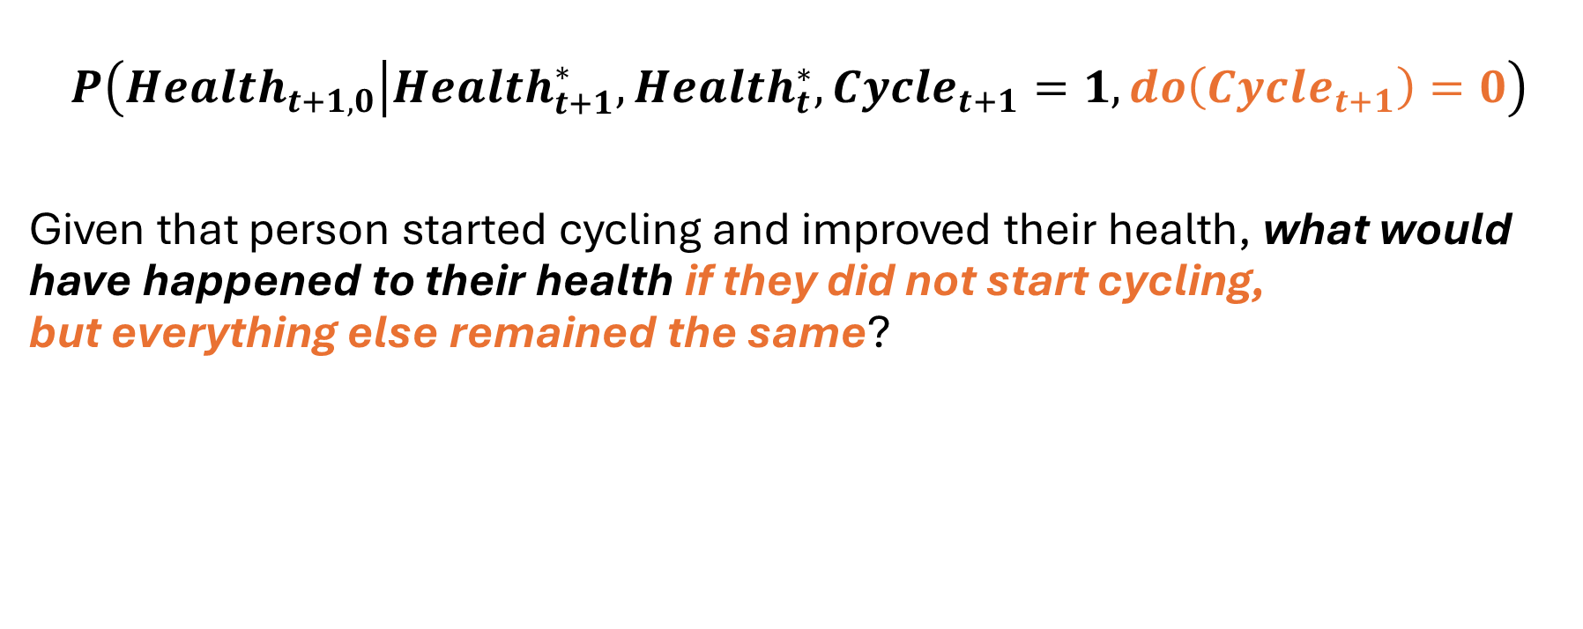
Counterfactual: Complicated to express formally, but intuitive to grasp
$$P\left(Health_{t+1,0} | Health_{t+1}^{∗}, Health_{t}^{∗}, Cycle_{t+1}=1, do\left(Cycle_{t+1}\right)=0\right)$$
Given that person started cycling and improved their health, what would have happened to their health if they did not start cycling, but everything else remained the same?

Slide 25
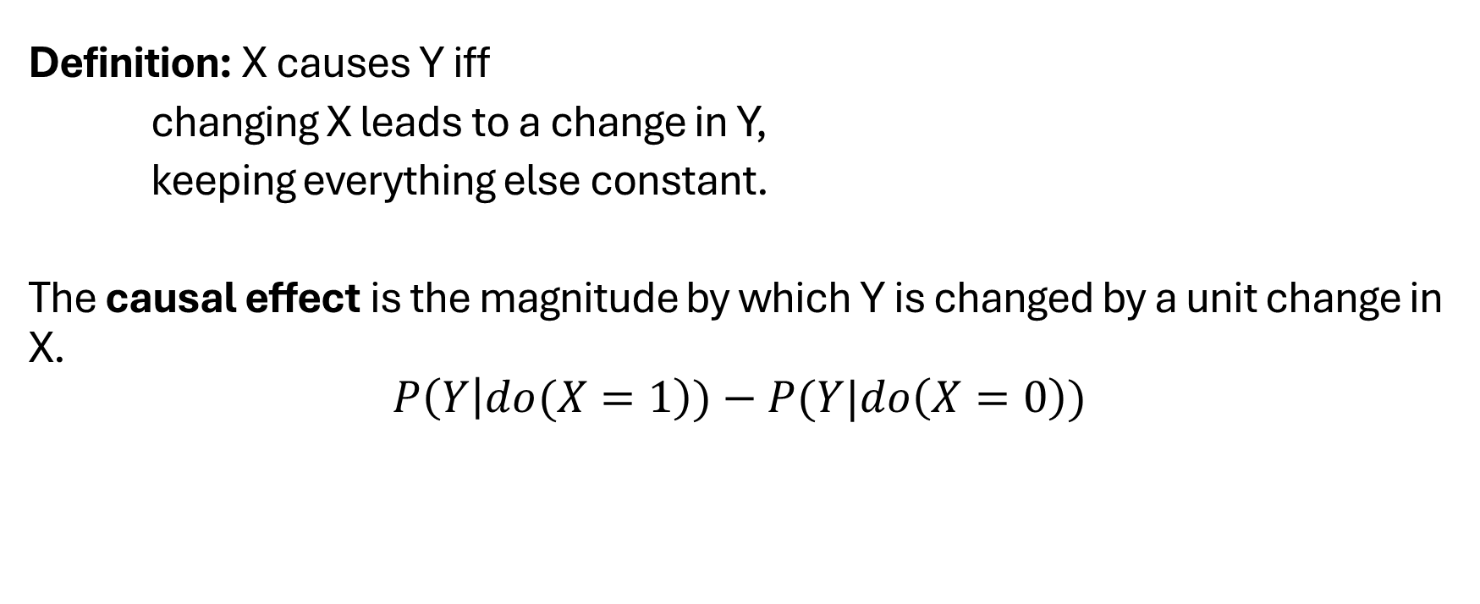
Now we are ready to define the causal effect of a variable
Definition: X causes Y iff
changing X leads to a change in Y,
keeping everything else constant.
The causal effect is the magnitude by which Y is changed by a unit change in X.
$$P\left(Y | do(X=1\right))−P(Y|do\left(X=0\right))$$
Real World
Counterfactual World
-

Slide 26
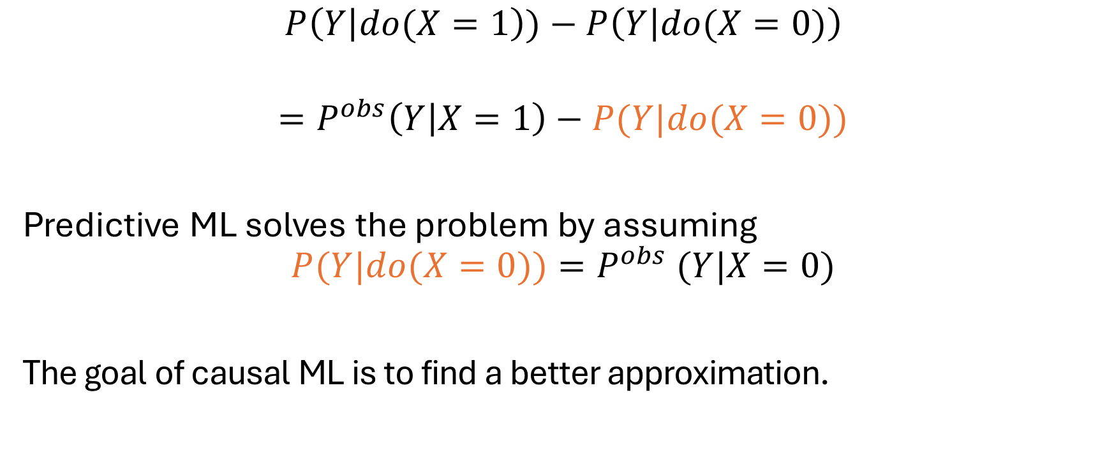
As we will see, the key problem is that one of the terms is never observed in data
$$P\left(Y | do(X=1\right))−P\left(Y | do(X=0)\right)$$
$$=P^{obs}\left(Y | X=1\right)−P(Y|do(X=0))$$
Predictive ML solves the problem by assuming
$$P(Y|do(X=0))=P^{obs} (Y|X=0)$$
The goal of causal ML is to find a better approximation.

Slide 27
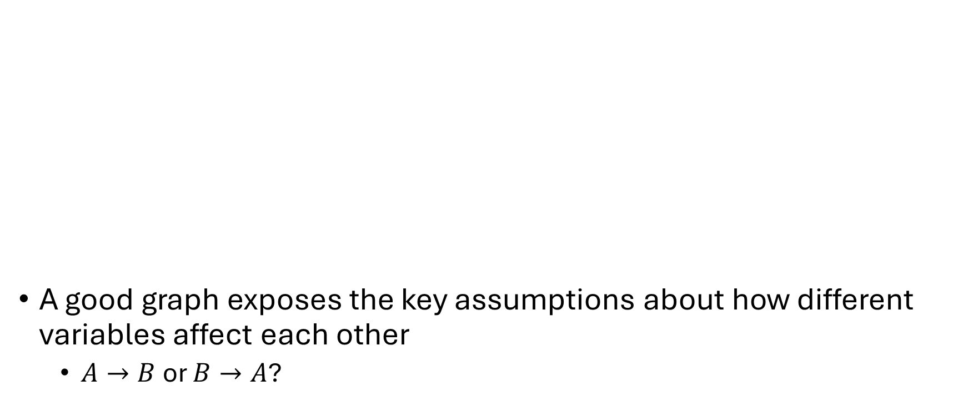
Final concept: Causal graph to encode assumptions that help estimate the unseen
A good graph exposes the key assumptions about how different variables affect each other
$A→B$or $B→A$?
Age
Other Attributes
Product usage
Cycling
Health
Discount
Renew contract

Slide 28
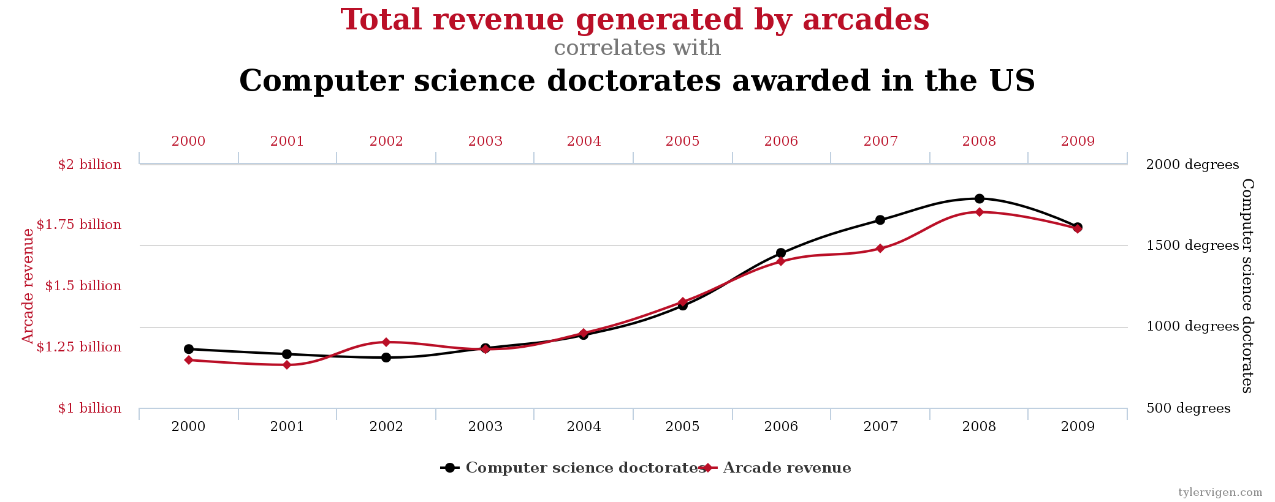
Failure case: What can happen without causal assumptions?
http://www.tylervigen.com/spurious-correlations

Slide 29
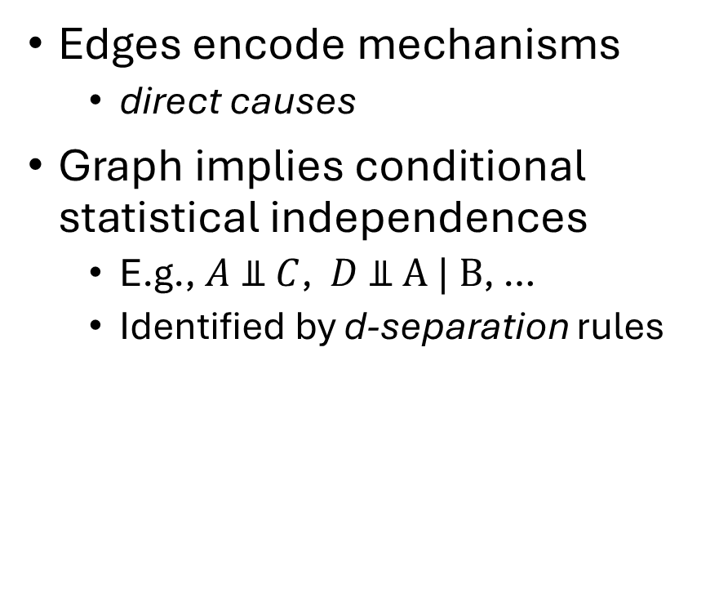
Interpreting a causal graph: d-separation
Edges encode mechanisms
direct causes
Graph implies conditional statistical independences
E.g., $A \text{⫫} C$, $D \text{⫫} \text{A}\text{ | }\text{B}$, …
Identified by d-separation rules
C
A
B
D

Slide 30

Interpreting a causal graph: d-separation
A
A
A
If conditioned on X
If conditioned on X
If not conditioned on X
Age
Three kinds of node-edges
Path is “blocked” → path is d-separated
T
Y
$$X=\{Age\}$$

Slide 31
Insight: The assumptions are not the edges you create, but the edges you omit
Assumptions are encoded by missing edges, and direction of edges
Relationships represent stable and independent mechanisms
It is not always possible to learn a graph from observational data

Slide 32
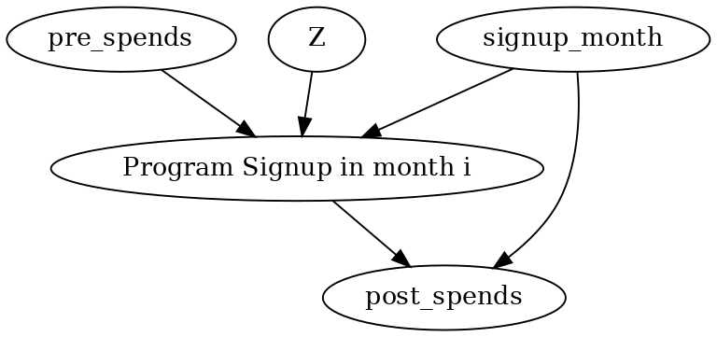
How to obtain a causal graph? Use domain knowledge (Example 1)
Estimating the effect of customer rewards program

Slide 33
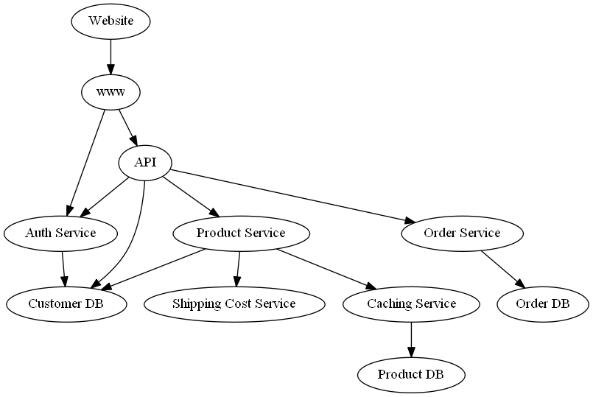
How to obtain a causal graph? Use domain knowledge (Example 2)

Slide 34
Section 3: Applications of causal ML (decision-making, root cause attribution, out-of-distribution generalization)

Slide 35
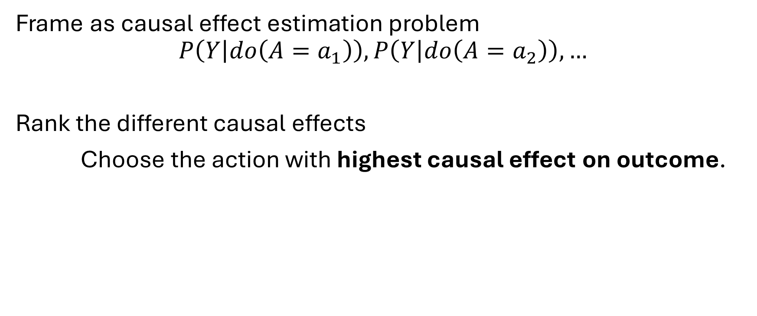
Decision-making: Given a target outcome, which action maximizes the outcome value?
Frame as causal effect estimation problem
$$P\left(Y | do\left(A=a_{1}\right)\right),P\left(Y | do\left(A=a_{2}\right)\right), …$$
Rank the different causal effects
Choose the action with highest causal effect on outcome.

Slide 36
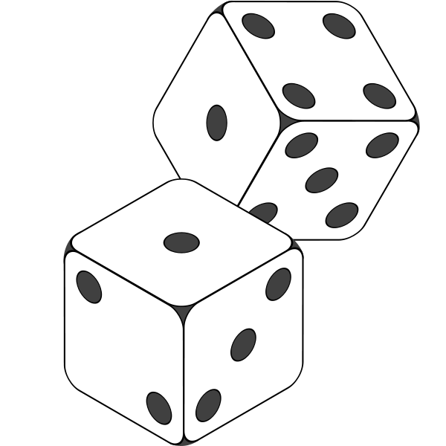
Randomized “A/B” test: A simple solution if you can intervene and create new data

Slide 37
But what to do if we cannot intervene?
People who do not cycle have high cholesterol
People who cycle regularly have low cholesterol

Slide 38
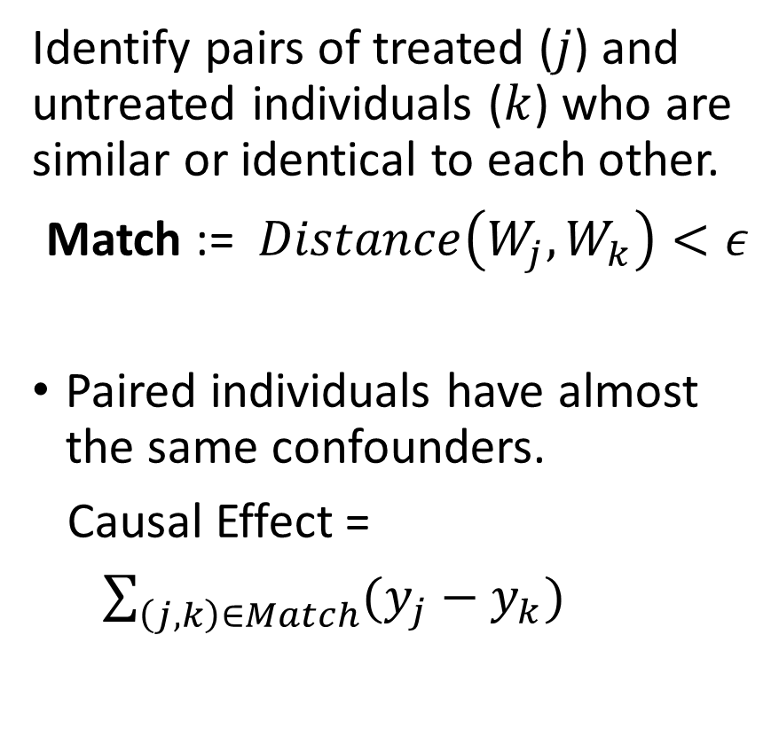
Simple Matching: Match data points with the same confounders and then compare their outcomes
Identify pairs of treated ($j$) and untreated individuals ($k$) who are similar or identical to each other.
Match := $Distance\left(W_{j}, W_{k}\right)<ε$
Paired individuals have almost the same confounders.
Causal Effect =
$\sum_{\left(j,k\right)∈Match}{(y_{j}−y_{k})}$
:
:
:
:
:
:
:
:
:

Slide 39
Challenges of building a good estimator
Variance: If we have a stringent matching criterion, we may obtain very few matches and the estimate will be unreliable.
Bias: If we relax the matching criterion, we obtain many more matches but now the estimate does not capture the target estimand.
Uneven treatment assignment: If very few people have treatment, leads to both high bias and variance.
Need better methods to navigate the bias-variance tradeoff.

Slide 40
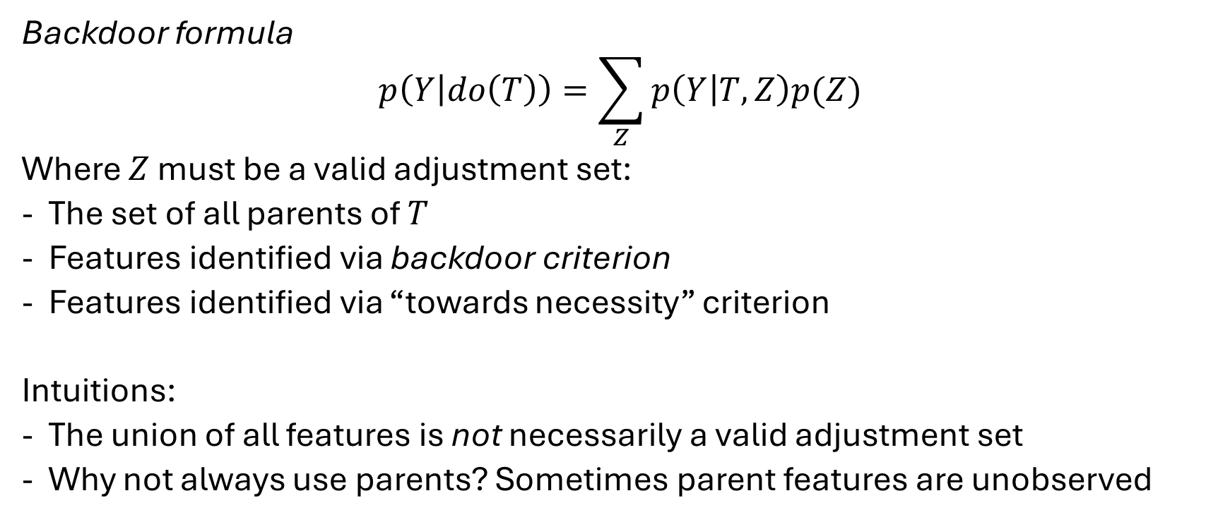
The intuition leads to a popular principle for estimating causal effect: backdoor criterion
Backdoor formula
$$p\left(Y | do\left(T\right)\right)=\sum_{Z}{p\left(Y | T,Z\right)p(Z)}$$
Where $Z$ must be a valid adjustment set:
The set of all parents of $T$
Features identified via backdoor criterion
Features identified via “towards necessity” criterion
Intuitions:
The union of all features is not necessarily a valid adjustment set
Why not always use parents? Sometimes parent features are unobserved

Slide 41
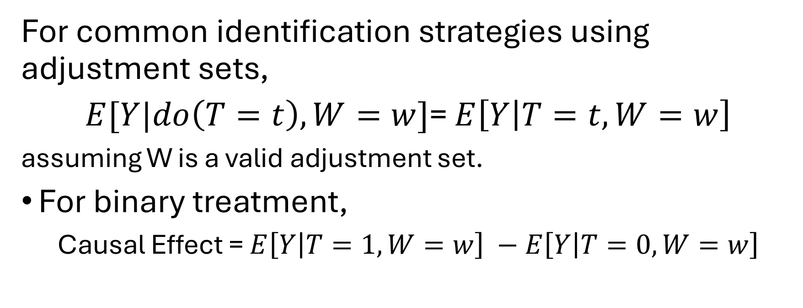
Voila! Effect inference problem reduced to estimating conditional expectation
For common identification strategies using adjustment sets,
$E[Y|do\left(T=t\right), W=w]$= $E\left[Y | T=t, W=w\right]$
assuming W is a valid adjustment set.
For binary treatment,
Causal Effect = $E\left[Y | T=1, W=w\right] −E\left[Y | T=0, W=w\right]$
Goal: Estimating conditional probability Y|T=t when all confounders W are kept constant.

Slide 42
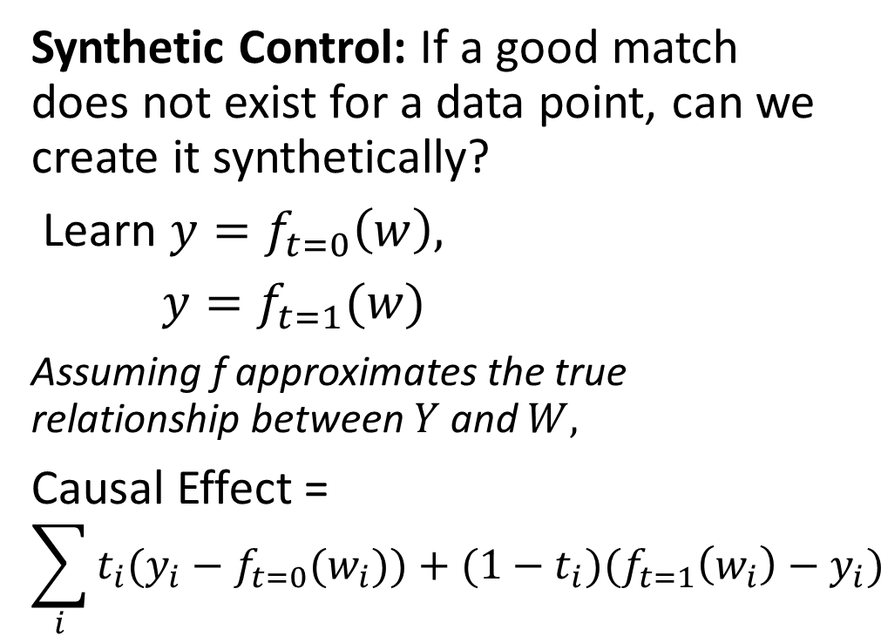
Machine learning methods can help find a better match for each data point
Synthetic Control: If a good match does not exist for a data point, can we create it synthetically?
Learn $y=f_{t=0}\left(w\right),$
$y=f_{t=1}(w)$
Assuming f approximates the true relationship between $Y$ and $W,$
Causal Effect =
$$\sum_{i}{{t_{i}(y}_{i}−f_{t=0}(w_{i}))+(1−t_{i})(f_{t=1}\left(w_{i}\right)−y_{i})}$$
T=1
Outcome (Y)
T=0
Confounder (W)
Confounder

Slide 43
A natural solution: Use regression

Slide 44
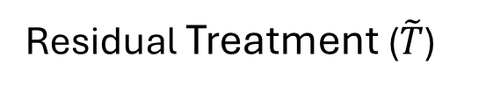
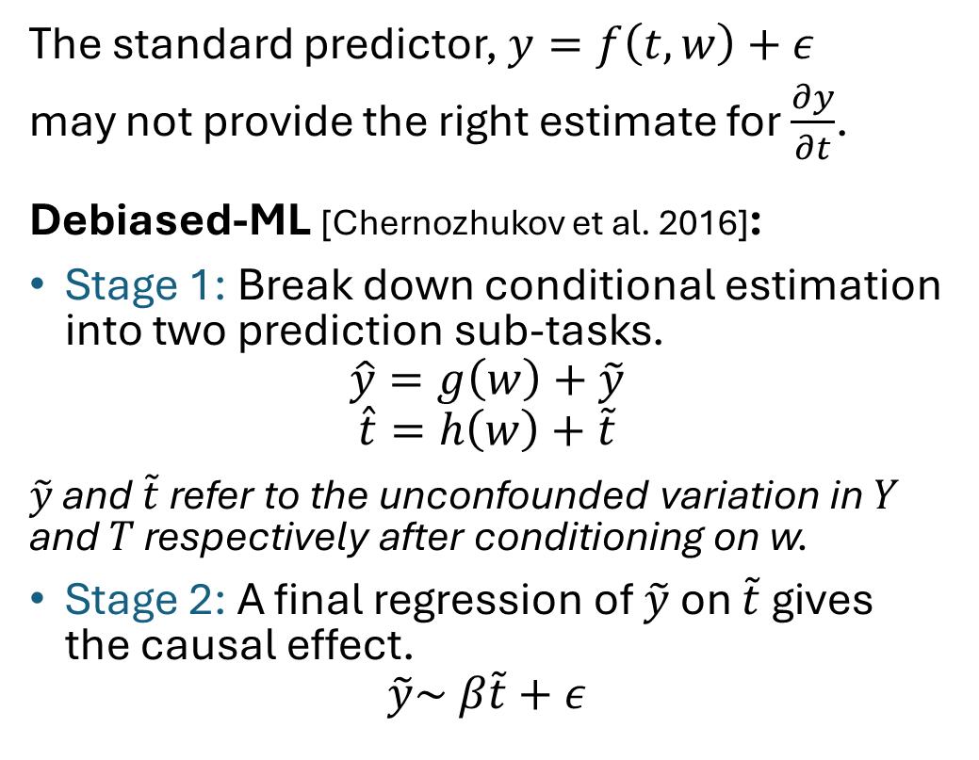
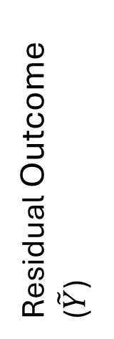
A better solution: use debiased ML estimator
The standard predictor, $y=f\left(t, w\right)+ε$
may not provide the right estimate for $\frac{∂y}{∂t}$.
Debiased-ML [Chernozhukov et al. 2016]:
Stage 1: Break down conditional estimation into two prediction sub-tasks.
$$\hat{y}=g\left(w\right)+\tilde{y}$$
$$\hat{t}=h\left(w\right)+\tilde{t}$$
$\tilde{y}$ and $\tilde{t}$ refer to the unconfounded variation in $Y$ and $T$ respectively after conditioning on w.
Stage 2: A final regression of $\tilde{y}$ on $\tilde{t}$ gives the causal effect.
$$\tilde{y}\sim β\tilde{t}+ε$$
Outcome (Y)
Treatment (T)
Confounder (W)
Confounder (W)
Residual Outcome ($\tilde{Y}$)
Residual Treatment ($\tilde{T}$)

Slide 45
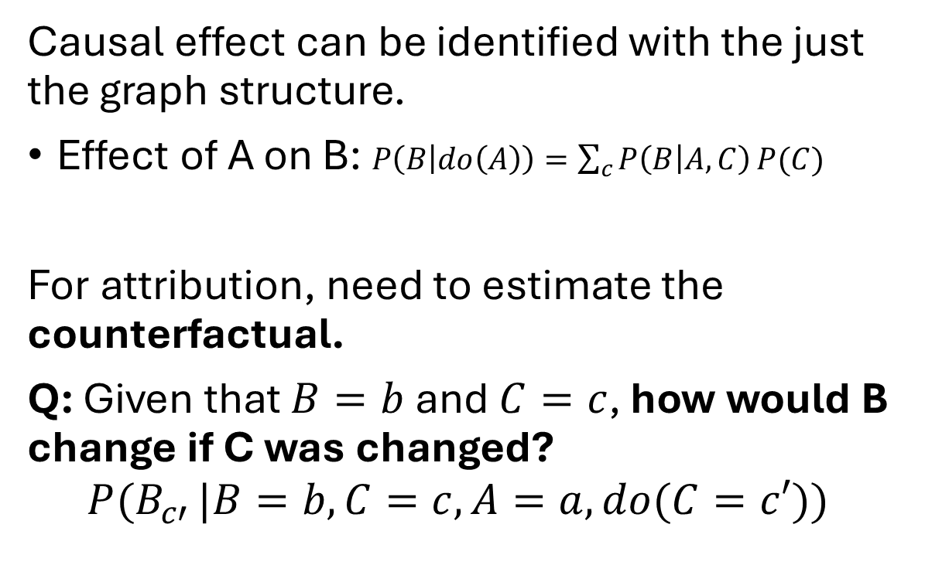
Second key application for causal ML: Root cause attribution
Causal effect can be identified with the just the graph structure.
Effect of A on B: $P\left(B | do\left(A\right)\right)=\sum_{c}{P\left(B | A,C\right)}P(C)$
For attribution, need to estimate the counterfactual.
Q: Given that $B=b$ and $C=c$, how would B change if C was changed?
$$P(B_{c′}^{}|B=b,C=c, A=a, do(C=c′))$$
C
A
B
D

Slide 46
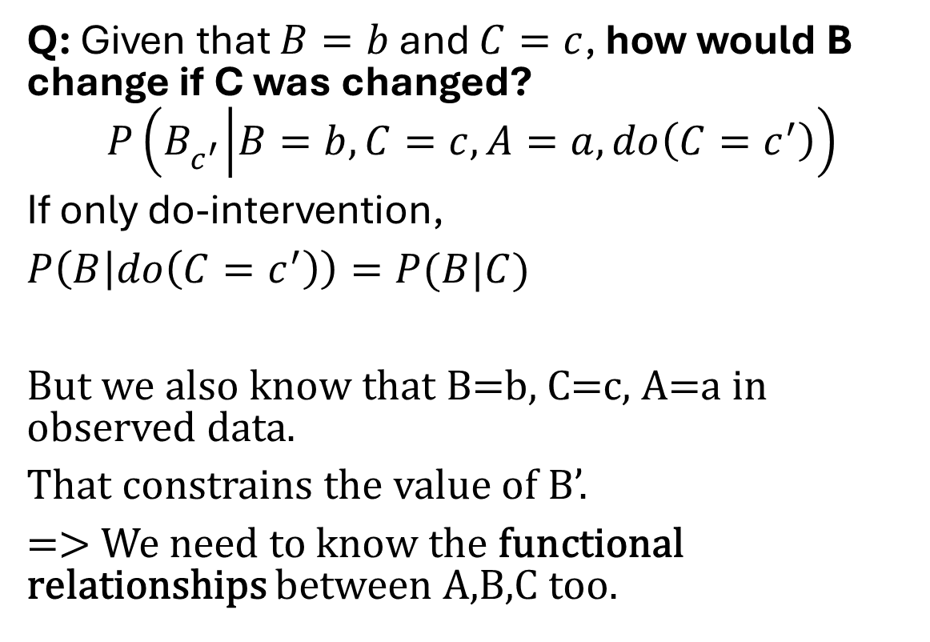
Second key application for causal ML: Root cause attribution
Q: Given that $B=b$ and $C=c$, how would B change if C was changed?
$$P\left(B_{c^{′}}^{} | B=b,C=c, A=a, do\left(C=c^{′}\right)\right)$$
If only do-intervention,
$P\left(B | do\left(C=c^{′}\right)\right)=P(B|C)$
But we also know that B=b, C=c, A=a in observed data.
That constrains the value of B’.
=> We need to know the functional relationships between A,B,C too.
C
A
B
D

Slide 47
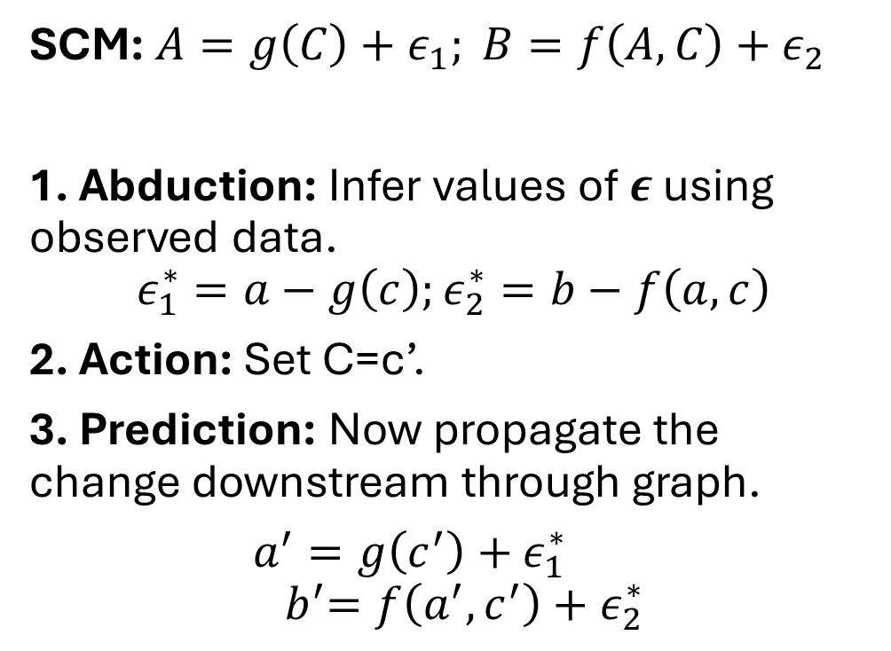
The counterfactual generation algorithm
SCM: $A=g\left(C\right)+ε_{1}; B=f\left(A,C\right)+ε_{2}$
1. Abduction: Infer values of $ε$ using observed data.
$$ε_{1}^{∗}=a−g\left(c\right);ε_{2}^{∗}=b−f\left(a,c\right)$$
2. Action: Set C=c’.
3. Prediction: Now propagate the change downstream through graph.
$a^{′}=g\left(c^{′}\right)+$ $ε_{1}^{∗}$
$${ b}^{′}=f\left(a^{′},c^{′}\right)+ε_{2}^{∗}$$
C
A
B
D

Slide 48
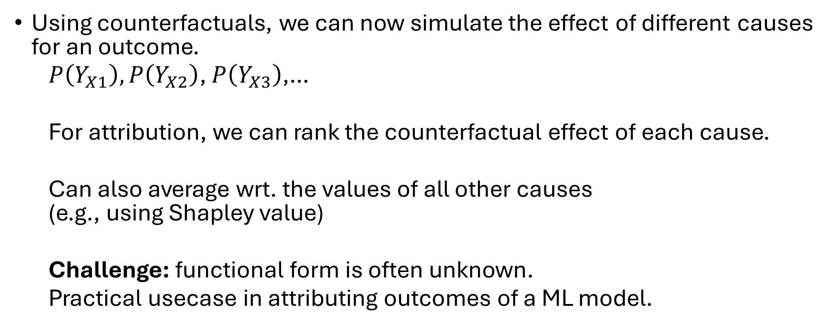
Root cause attribution: Ranking over counterfactuals
Using counterfactuals, we can now simulate the effect of different causes for an outcome.
$P\left(Y_{X1}\right),P\left(Y_{X2}\right)$, $P\left(Y_{X3}\right)$,…
For attribution, we can rank the counterfactual effect of each cause.
Can also average wrt. the values of all other causes (e.g., using Shapley value)
Challenge: functional form is often unknown.
Practical usecase in attributing outcomes of a ML model.

Slide 49
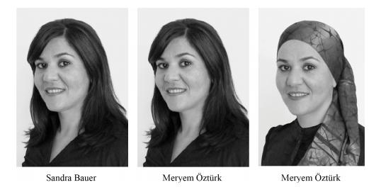
Example: Consider a classification ML model over face images
Let’s say there is a trained binary classification model using the image.
It outputs class=1 for image 1. Why?
We may look at important features through ML explanation models like LIME, SHAP etc.
But those do not tell us how the model will behave if we change the input.

Slide 50

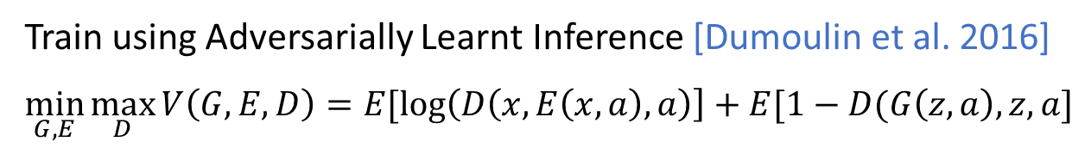

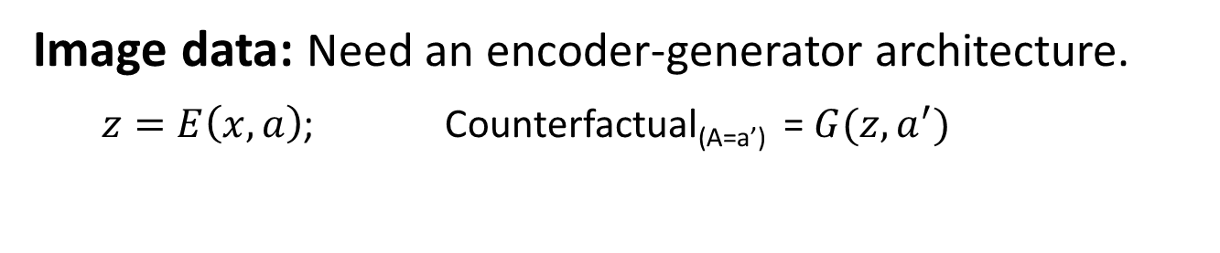
How to generate a counterfactual for a ML model
Tabular data: Simply change the input name.
Image data: Need an encoder-generator architecture.
$z=E\left(x,a\right)$; Counterfactual_{(A=a’)} = $G(z, a^{′})$
X
ENCODER
Z
GENERATOR
$$\hat{X}$$
A
Train using Adversarially Learnt Inference [Dumoulin et al. 2016]
$$\min_{G,E}{\max_{D}{V\left(G,E,D\right)=E[\log\left(D\left(x, E\left(x,a\right),a\right)\right]+E[1−D(G\left(z,a\right), z,a]}}$$

Slide 51
Evaluating a ML classifier on a Face dataset
CelebA dataset (Photos with 40 attributes like hair color, skin color, etc.)
Generate counterfactuals for each image.
Given a CNN classifier for one of the attributes (“attractiveness”), trained using standard loss minimization.
Explain: Which attributes are considered important for prediction?
Fairness: Is it fair wrt. certain attributes (pale skin attribute)?
Reconstructed
BlackHair
BlackHair, PaleSkin
BlondeHair
BlondeHair, PaleSkin

Slide 52
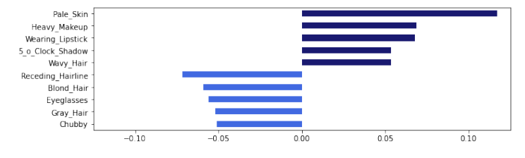
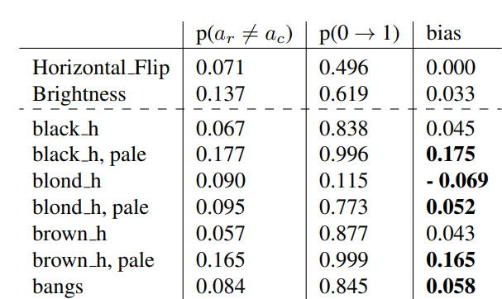
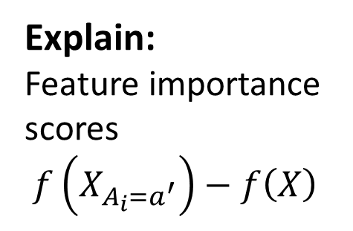
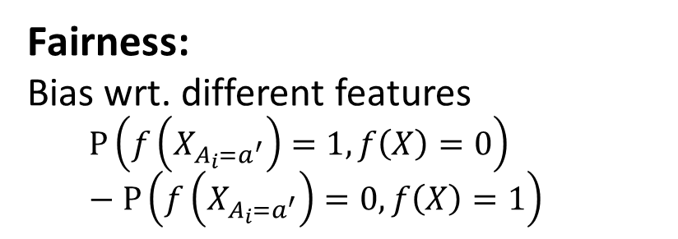
Explain:
Feature importance scores $f\left(X_{A_{i}=a^{′}}\right)−f\left(X\right)$
Fairness: Bias wrt. different features
$$P\left(f\left(X_{A_{i}=a^{′}}\right)=1, f\left(X\right)=0\right)−P\left(f\left(X_{A_{i}=a^{′}}\right)=0, f\left(X\right)=1\right)$$

Slide 53
Third key application for causal ML: Out-of-distribution generalization
Domain generalization
Multiple domains: Assume access to data from multiple distributions
Learn invariant patterns across the different sources
Invariant Risk Minimization (Arjovsky et al., 2019)
(Krueger et al. 2020, Ganin et al. 2016, Gulrajani & Lopez-Paz 2021, Nam et al. 2021)
Group generalization
Single domain: Assume access to group attributes for each input
Equalize accuracy across groups/maximize worst-group accuracy
Group-DRO (Sagawa et al., 2020), (Ahmed et al. 2021)

Slide 54
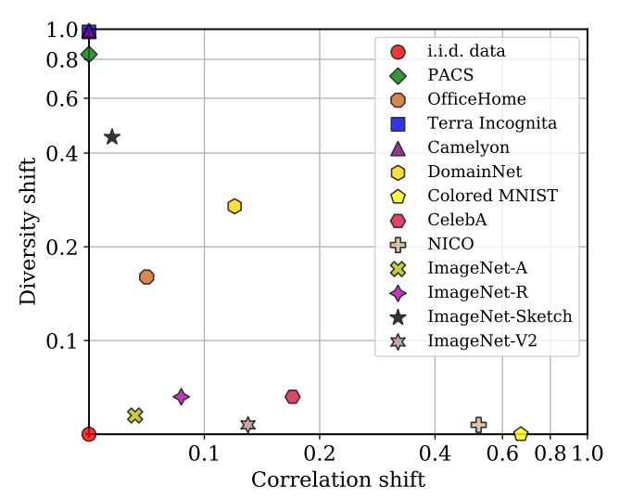
Sobering state of SoTA algorithms
Ye et al., OoD-Bench, CVPR 2022
Notes:
Start by discussing the state of current DG algorithms as presented in some recent works
OoD bench from this year’s CVPR formally defined two types of shifts: diversity and correlation. While diversity shift is caused by novel feature values in the test environment, correlation shift stems from spurious correlation b/w features and the label. If you see in the plot, datasets circled in red in the extreme top left demonstrate diversity shift and ones circled in green in bottom right are correlation shift datasets

Slide 55
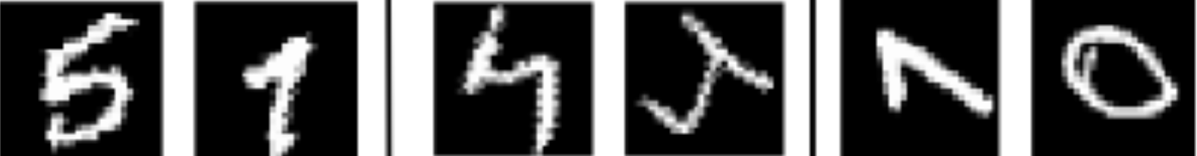
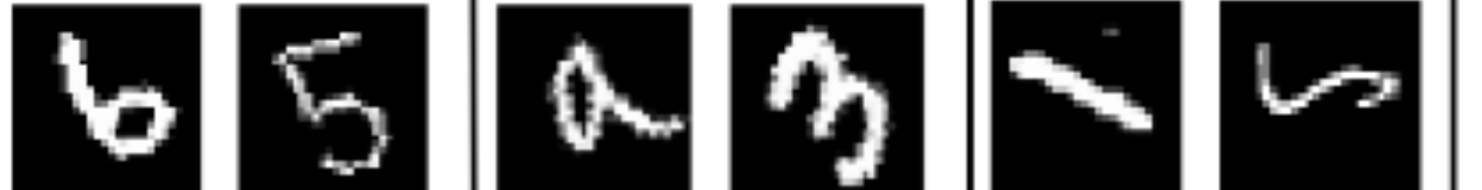
Sobering state of SoTA algorithms
 | Train |  | Test
 | 15° | 60° | 90°
Y=0
Y=1
Rotated MNIST
Ye et al., OoD-Bench, CVPR 2022
Notes:
To explain better, a common eg of diversity shift will be Rot MNIST which is characterized by unseen rotation values during test time.

Slide 56
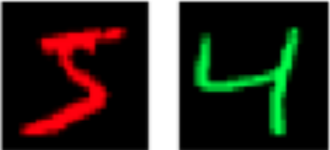
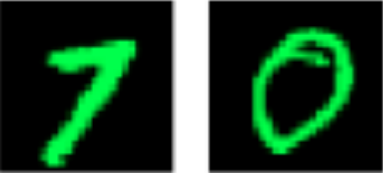

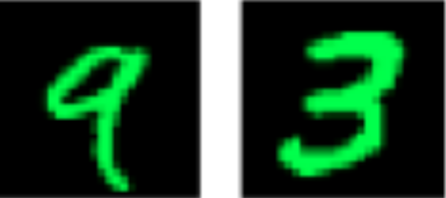

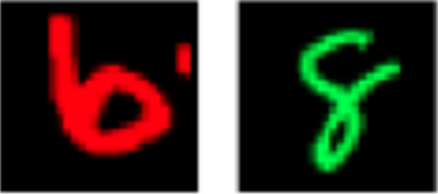
Sobering state of SoTA algorithms
 | Train |  | Test
 | 15° | 60° | 90°
Y=0
Y=1
Rotated MNIST
 | Train |  | Test
 | 0.9 | 0.8 | 0.1
Y=0
Y=1
Ye et al., OoD-Bench, CVPR 2022
Colored MNIST
Notes:
And Colored MNIST for Correlation shifts as the domains are created by changing the correlation between the class label and spurious attribute which is color here

Slide 57
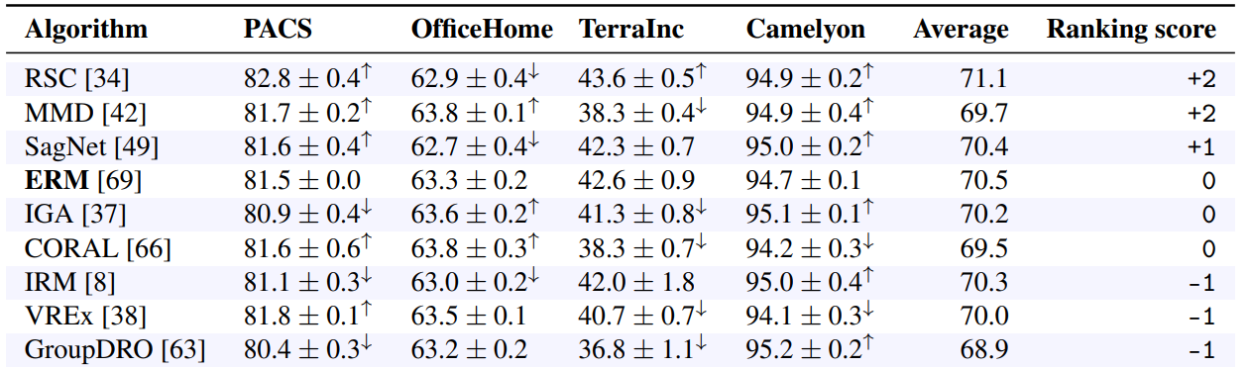
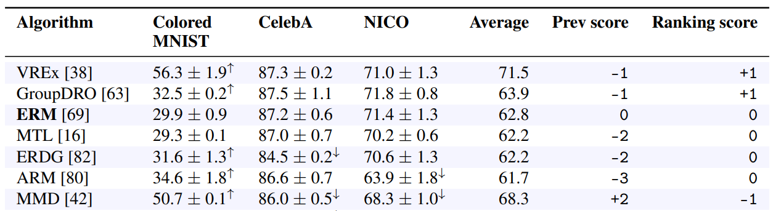



Sobering state of SoTA algorithms
Ye et al., OoD-Bench, CVPR 2022
Notes:
They compute relative ranking of algorithms wrt ERM (highlighted in yellow) and find that

Slide 58
Sobering state of SoTA algorithms
No method can surpass ERM on all kinds of shifts!
Ye et al., OoD-Bench, CVPR 2022
Notes:
majority of DG algorithms are able to outperform ERM in only one of the categories of shifts

Slide 59

Sobering state of SoTA algorithms
[Correlation Shift] [Diversity Shift]
IID
Spurious correlation
b/w category and lighting
Unseen data shift
unseen azimuth values
Best methods are not consistent over different datasets and shifts
Wiles et al., ICLR 2022
Notes:
Another very recent work provides an extensive analysis of current state-of-the-art methods by evaluating them on real world and synthetic datasets across diff distribution shifts. They consider Sp correlation and unseen data shifts which are respectively very similar to the corr and diversity shifts discussed earlier.
This work also presents consistent findings as OoD Bench in terms of there being no single best method across datasets and shifts.

Slide 60
What if different distribution shifts co-exist?
Train | Test
Satellite Image (x)
Year / Region (d)
Building / Land Type (y)
Koh et al., WILDS, ICML 2021
Notes:
While we saw that no algorithm performs well over all different kinds of shifts, these shifts have been studied individually. However, real world data does not often exhibit a single kind of shift in isolation but rather presents different kinds of shifts over multiple attributes which is an even harder problem.
Taking an example from the WILDS dataset to emphasize on this further, we see distribution shifts in satellite images over both year of capturing the image as well as the region covered – and this is just one of the many real world situations where multiple attrs are involved

Slide 61


What if different distribution shifts co-exist?
 | Train |  | Test
 | 15° | 60° | 90°
Y=0
Y=1
Rotation
 | (0.9,15°) | (0.8,60°) | (0.1,90°)
Y=0
Y=1
+
Col+Rot
 | Train |  | Test
 | 0.9 | 0.8 | 0.1
Y=0
Y=1
Color
Accuracy decreases further for all algorithms.
Algorithm | Color | Rotation | Col+Rot
ERM | 30.9 ± 1.6 | 61.9 ± 0.5 | 25.2 ± 1.3
IRM | 50.0 ± 0.1 | 61.2 ± 0.3 | 39.6 ± 6.7
MMD | 29.7 ± 1.8 | 62.2 ± 0.5 | 24.1 ± 0.6
C-MMD | 29.4 ± 0.2 | 62.3 ± 0.4 | 32.2 ± 7.0
Notes:
We study this harder and closer to real world setup involving multi-attribute shifts in our work.
As an example, we combine Colored MNIST [3] and Rotated MNIST [9] to introduce distinct shifts over Color and Rotation attributes..

Slide 62
I. Causal reasoning can explain this failure
[single shift] Explain results from causal perspective
Different distribution shifts arise due to differences in data-generating process (DGP)
Leading to different independence constraints
No single independence constraint can work for all shifts
Notes:
For the single shift datasets discussed in past work: We asked ourselves the question that: Why is no method performing well consistently?; and we explain these past results from a causal perspective. Diff distr shifts…… which leads to diff ind constraints.. And hence…
In fact, we theoretically prove this claim, and I’ll come to that in a while

Slide 63
II. Causal reasoning can provide a better algorithm
[single shift] Explain results from causal perspective
Different distribution shifts arise due to differences in data-generating process (DGP)
Leading to different independence constraints
No single independence constraint can work for all shifts
[multi-shift] Can we develop an algorithm that generalizes to individual as well as multi-attribute shifts?
We propose Causally Adaptive Constraint Minimization (CACM) to model the causal relationships in DGP
Notes:
We go on to ask if can we develop an algo that generalizes to not just individual but also multi-attr shifts? And as a solution we propose …………. To model the causal relns in the Data generating process

Slide 64

Representation of shifts using causal graph
Causal DAG to specify multi-attribute shifts
Notes:
We use a general causal DAG to represent the diff distribution shifts

Slide 65

Representation of shifts using causal graph
Observed variables $X,Y$
Causal DAG to specify multi-attribute shifts
Notes:
Here, X and Y are the observed variables representing the input and target class respectively

Slide 66

Representation of shifts using causal graph
Observed variables $X,Y$
Causal features $Xc$
Causal DAG to specify multi-attribute shifts
Notes:
Xc is the set of stable or causal features and Xc alone cause Y

Slide 67

Representation of shifts using causal graph
Observed variables $X,Y$
Causal features $Xc$
Attributes $A_{ind},A_{\overline{ind}}, E$ st${ A}_{ind} ∪A_{\overline{ind}} ∪ \{E\}=A$
Causal DAG to specify multi-attribute shifts
Notes:
And coming on to our nuisance attrs – we categorize the set of all attrs A into Aind, Anot ind and E

Slide 68

Representation of shifts using causal graph
Observed variables $X,Y$
Causal features $Xc$
Attributes $A_{ind},A_{\overline{ind}}, E$ st${ A}_{ind} ∪A_{\overline{ind}} ∪ \{E\}=A$
Correlation Shift
independent of label
correlated with label
domain attribute
Diversity Shift
Causal DAG to specify multi-attribute shifts
Notes:
Aind is the set of attributes that are independent of label, A not ind represents the attributes correlated with label, and E is a special attribute for the domain

Slide 69

Representation of shifts using causal graph
Causal DAG to specify multi-attribute shifts
Different $Y −A_{\overline{ind}}$relationships
Notes:
We characterize different kinds of shifts based on the relationship between nuisance attributes A and the classification label Y. Aind has varying distribution across environments but is Independent of the class label as seen from the graph. The dashed bidirectional arrow represents the correlation between Anot ind and Y; and There are different mechanisms which can introduce this dashed-line relationship

Slide 70

Representation of shifts using causal graph
Independent
Causal
Causal DAG to specify multi-attribute shifts
Different $Y −A_{\overline{ind}}$relationships
Notes:
direct-causal relationship (Y causing Anot ind)

Slide 71
Representation of shifts using causal graph
Confounded
Independent
Causal
Causal DAG to specify multi-attribute shifts
Different $Y −A_{\overline{ind}}$relationships
Notes:
confounding between Y and Anot ind due to a common cause,

Slide 72
Representation of shifts using causal graph
Selected
Confounded
Independent
Causal
Causal DAG to specify multi-attribute shifts
Different $Y −A_{\overline{ind}}$relationships
Notes:
or selection during the data-generating process. Thus, we define four kinds of shifts based on the causal graph: Independent, Causal, Confounded, and Selected To summarize, A can be split into Aind , A not ind and E, where Anot ind can be further split into subsets that have a causal (Acause ), confounded (Aconf ), selected (Asel ) relationship with Y

Slide 73


Back to the MNIST example
 | Train |  | Test
 | 15° | 60° | 90°
Y=0
Y=1
Rotation
 | (0.9,15°) | (0.8,60°) | (0.1,90°)
Y=0
Y=1
$$A_{ind }$$
Col+Rot
+
Causal + Independent
 | Train |  | Test
 | 0.9 | 0.8 | 0.1
Y=0
Y=1
$${A_{\begin{aligned}cause \\ \end{aligned}}∪ A}_{ind }$$
Color
$$A_{\begin{aligned}cause \\ \end{aligned}}$$
$${(A}_{\overline{ind}})$$
Notes:
Coming back to our multi-attribute setup, we see colored+rot mnist is a combined causal and ind shift setting

Slide 74
Generalization to multi-attribute shifts
Algorithm | Color | Rotation | Col+Rot
ERM | 30.9 ± 1.6 | 61.9 ± 0.5 | 25.2 ± 1.3
IRM | 50.0 ± 0.1 | 61.2 ± 0.3 | 39.6 ± 6.7
MMD | 29.7 ± 1.8 | 62.2 ± 0.5 | 24.1 ± 0.6
C-MMD | 29.4 ± 0.2 | 62.3 ± 0.4 | 32.2 ± 7.0
CACM | 70.4 ± 0.5 | 62.4 ± 0.4 | 54.1 ± 0.3
CACM outperforms on individual as well as combination of shifts
Notes:
Whereas our proposed algorithm CACM outperforms these algos on individual as well as combined shifts.
It is important to note that we do not assume access to the full causal graph but only the relationship between label and an attribute, and unlike the full graph, this relationship is often known – by virtue of data collection or using domain knowledge.

Slide 75
The CACM Approach
Identifying the correct regularizer under multi-attribute shifts
Notes:
To perform well under these diff kinds of shifts, we introduce an approach that identifies the correct regularizer based on the underlying causal graph

Slide 76

The CACM Approach
Identifying the correct regularizer under multi-attribute shifts
Derive correct independence constraints for $Xc$ based on causal graph
Apply the constraints as regularizer to standard ERM loss.
Notes:
This involves two steps: the first is to….. Second is to apply…..

Slide 77

Step I: Deriving independence constraints
Predictor $g\left(x\right)=g1(φ(x))$
Representation $φ$ should follow same conditional independence constraints as $Xc$
Mahajan et al., ICML 2021; Veitch et al., NeurIPS 2021; Makar et al., AISTATS 2022
Notes:
We assume that the predictor can be represented as g1(ϕ(x)) where ϕ is the representation. To derive the correct ind constraints, we utilize a strategy from past work. We identify the conditional independence constraints satisfied by Xc in the causal graph and enforce that learnt representation ϕ should follow the same constraints.

Slide 78

Step I: Deriving independence constraints
Predictor $g\left(x\right)=g1(φ(x))$
Representation $φ$ should follow same conditional independence constraints as $Xc$
Proposition 3.1. Given a dataset ${\left(x_{i},a_{i},y_{i}\right)}_{i=1}^{n}$and a causal DAG over ⟨ $Xc$, $X$, $A$, $Y$ ⟩ such that $Xc$is the only variable (or set of variables) that causes $Y$ and is not independent of $X$, then the conditional independence constraints satisfied by $Xc$ are necessary for a risk-invariant predictor.
Notes:
We justify this strategy theoretically by showing that the conditional ind constraints satisfied by Xc are necessary for a risk inv predictor. Please refer to the paper for the proof.

Slide 79


Step I: Deriving independence constraints
Causal
Confounded
Different $Y −A_{\overline{ind}}$relationships lead to different constraints
Notes:
To provide an eg for how constraints can differ for diff shifts, consider causal and confounded shifts here

Slide 80




Step I: Deriving independence constraints
Causal
Confounded
$$Xc⊥⊥A_{cause }| Y, E$$
$$Xc⊥⊥A_{cause }| E$$
$$Xc⊥⊥A_{conf }| Y, E$$
$$Xc⊥⊥A_{conf }| E$$
Notes:
In the causal shift, we can see it becomes imp to condition on Y as Xc is not ind of Acause however for the confounded shift Y forms a collider on the path from Xc to Aconf making Xc and Aconf independent and hence we cannot condition on Y

Slide 81

Step II: Applying regularization penalty
Constraint: $Xc⊥⊥A_{cause }| Y, E$ [Causal shift]
$$RegPenalty_{Acause}=\sum_{\left|E\right|}{\sum_{y∈Y}{\sum_{i=1}^{\left|A_{cause}\right|}{\sum_{j>i}{MMD\left(P\left(g_{1}\left(φ(x\right)) | a_{i, cause},y\right),P\left(g_{1}\left(φ(x\right)) | a_{j, cause},y\right)\right)}}}}$$
$$g_{1},φ=argmin_{g_{1},φ} L\left(g_{1}\left(φ\left(x\right)\right),y\right)+λ^{∗}\left(RegPenalty_{Acause}\right)$$
Notes:
The next step is to enforce these constraints by applying a regularization penalty We show the penalty here for causal shift for the corresponding constraint listed here. We condition on Y and use MMD to minimize the distributional discrepancy between P (g1(x)) for diff values of Acause attribute.

Slide 82
Summary of Session 1
Causal ML is important whenever we have decision-making or attribution tasks, or want generalizability of predictive model beyond the training distribution.
Causal graph is the most important assumption.
“No causes in, no causes out” – Judea Pearl
The goal is to develop methods that use the least amount of assumptions.
E.g., debiased ML for effect estimation
Simple, high-level causal graph for images

